Slide 1
Virtual University ENG 101
Lesson -8
Dr.Surriya Shaffi Mir

Slide 2
We have already looked at how words can be formed by looking at suffixes. In today’s lesson we will look at some other ways, beginning with prefixes and stem words, followed by synonyms and antonyms as a means of enhancing your vocabulary.
A prefix is a letter or group of letters that is added to the beginning of a stem/ base word e.g in untrue the prefix is un- and the stem/base word is true. Words that are unfamiliar to you may sometimes consist of a stem word you know and an added prefix , for instance,
We were shocked to learn of the illimitability of the dictator’s power.

Slide 3
Illimitability is a word that does not often appear in print. It may be unfamiliar to you. However, you can locate its stem word, limit, which means ‘to restrict’. If you also know that the prefix il- ( as in illegal) means ‘not’, you should be able to determine that illimitability refers to that which has no limits or restriction. The sentence means ‘ we were shocked to learn that there is no limit to the dictator's power.
Now you will look at a list of words in which adapt is the stem/ base word. If this word is preceded by a prefix you can make twenty -four additional words.

Slide 4
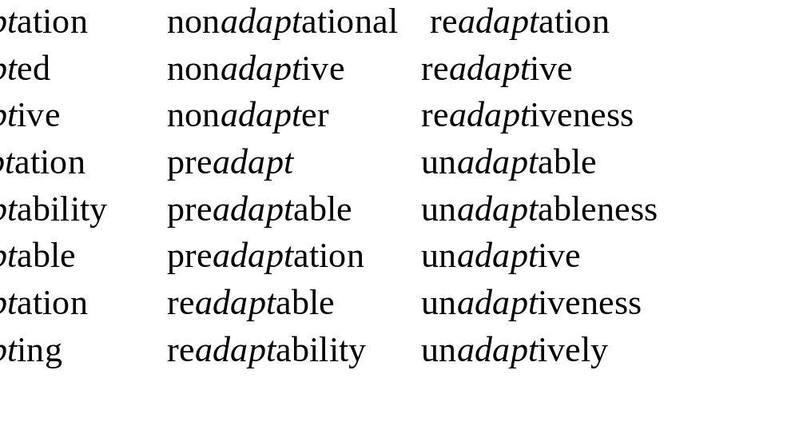

Slide 7
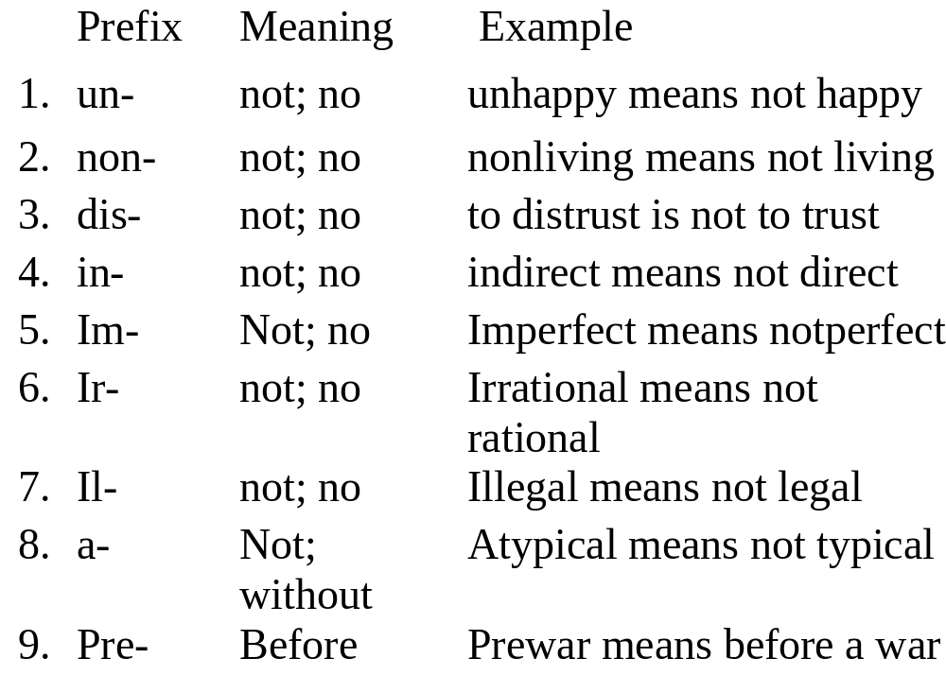

Slide 8
10post- after postwar means after a war
11anti- oppos(ing) antiwar means opposing war
12pro- favour(ing) prowar means favoring war
13inter- between interstate means between states
14hyper- excessive(ly) hyperactive means excessively active

Slide 9
15 mal- bad(ly) malnutrition is bad nutrition
16 mis- incorrect(ly) to misspell is to spell incorrectly
17 pseudo- false (ly) a pseudoscience is a false science
18 semi- partly semipublic means partly public
19 re- again to rewrite is to write again

Slide 12
Defining Words with Prefixes
Make sentences by writing the base/stem words and the meanings of the prefixes in the boldface words on the lines provided.
1. Hermits are asocial people
They are ___________________ people.
2. The child’s hyperactivity is alarming.
The child is _______________________
3. Outer space is illimitable
There is _________________ to outer space.

Slide 13
4. The castle was Impenetrable to ancient armies.
Ancient armies could ___________________
the castle.
5. We took an intercontinental flight.
We took a flight _____________________.
6. The fire did irreparable damage to the house.
They could __________________________
the damage to the house.
7. Did he make a maladjustment to marriage?
Did he ______________________ to marriage?

Slide 14
8. The story is pseudobiographical.
It is a ______________________________.
9. The patient is semiconscious.
The patient is _______________________.
10. Some thoughts are unutterable.
Some thoughts one can __________________.

Slide 15
Defining Words with Prefixes
Make sentences by writing the base words and the
meanings of the prefixes in the boldface words on
the lines provided.
1. Hermits are asocial people
They are ___________________ people.
2. The child’s hyperactivity is alarming.
The child is _______________________
3. Outer space is illimitable
There is _________________ to outer space.

Slide 16
4. The castle was impenetrable to ancient armies.
Ancient armies could ___________________
the castle.
5. We took an intercontinental flight.
We took a flight _____________________.
6. The fire did irreparable damage to the house.
They could __________________________
the damage to the house.
7. Did he make a maladjustment to marriage?
Did he ______________________ to marriage?

Slide 17
8. The story is pseudobiographical.
It is a ______________________________.
9. The patient is semiconscious.
The patient is _______________________.
10. Some thoughts are unutterable.
Some thoughts one can __________________.

Slide 18
If you know that adapt means ‘to make suitable’ and you also know the meanings of the prefixes mal-, non-, pre-, re-, and un- you know the the essential meanings of these twenty four words, even if you have not seen them in print before.
You will now look at nineteen prefixes and by understanding the most useful meanings of these common English prefixes you will increase your vocabulary by hundreds or even thousands of words in a very short time.

Slide 19
Word Formation - Prefixes
Let us now consider some more prefixes, their usual meanings, and how they change the meanings of English words. These prefixes will make words related to computers.
PREFIXES
NEGATIVE SIZE LOCATION TIME AND NUMBER
POSITIVE ORDER
un- semi- inter- pre- mono-
non- mini- super- ante- bi-
in- micro- trans- fore- hex-
dis- ex- post- oct-
re- extra- multi-
mid-

Slide 20
Study these tables and try to find additional examples. Use
your dictionary if necessary.
Negative and positive prefixes
PREFIX MEANING EXAMPLES
un- unmagnetized, in- not, unpunched
im- not good enough incomplete
il- impossible
ir- illegal
irregular, irrelevant
non- not connected with non-programmable,
non-impact
Negative

Slide 21
Negative and positive prefixes
PREFIX MEANING EXAMPLES
mis- bad, wrong mispronounce
dis- opposite feeling disagree
opposite action disconnect
anti- against antisocial
de- reduce, reverse demagnetize, decode
under- too little underestimate
Negative
re- do again reorganize
over- too much overheat
Positive

Slide 22
Prefixes of Size
PREFIX MEANING EXAMPLES
semi- half, partly semiconductor
equi- equal equidistant
maxi- big maxicomputer
micro- small microcomputer
mini- little minicomputer
macro- large macroeconomics
mega- megabyte

Slide 23
Prefixes of Location
PREFIX MEANING EXAMPLES
inter- between, interface, interactive
among
super- over supersonic
trans- across transmit, transfer
ex- out exclude, extrinsic
extra- beyond extraordinary
sub- under subschema
infra- below infra-red
peri- around peripheral

Slide 24
Prefixes of Time and Order
PREFIX MEANING EXAMPLES
ante- before antecedent
pre- prefix
prime- first primary, primitive
post- after postdated
retro- backward retroactive

Slide 25
Prefixes of Numbers
PREFIX MEANING EXAMPLES
semi- half semicircle
mono- one monochromatic
bi- two binary
tri- three triangle
quad- four quadruple
penta- five Pentagon
hex- six hexadecimal
septem- seven September
oct- eight octal
dec- ten decimal
multi- many multiprogramming, multiplexor

Slide 26
Other Prefixes
PREFIX MEANING EXAMPLES
pro- for program
auto- self automatic
co- together coordinate
neo- new neoclassical
pan- all Pan-Islamic

Slide 27
Exercise 2
Read the following sentences and underline all the
prefixes. Then try to find out what the prefixes mean
by referring back to the tables you have just completed
1. Non-impact printers are inexpensive and silent.
2. Tape-marks are unmagnetized reflective strips
stuck onto the tape.
3. The octal and the hexadecimal systems are
number systems used as a form of shorthand in
reading groups of four binary digits.
4. The internal shortage locations of a computer are
called its primary memory.

Slide 28
5. Multiprogramming is when more than one
program can be present at different storage
locations of the memory at the same time.
6. Peripheral devices can be either input devices
(such as card readers) or output devices (such as
printers).
7. The decoder ( a component of the control unit)
takes the coded instruction and breaks it down
into the individual commands necessary to carry
it out.
8. Microcomputers are becoming very important
in small business applications

Slide 29
9. A tape drive transmits the electromagnetic
impulses to the memory of the computer.
10. Semiconductor materials are used in the making
of transistors.

Slide 30
Exercise 2
Read the following sentences and underline all the
prefixes. Then try to find out what the prefixes mean
by referring back to the tables you have just completed
1. Non-impact printers are inexpensive and silent.
2. Tape-marks are unmagnetized reflective strips
stuck onto the tape.
3. The octal and the hexadecimal systems are
number systems used as a form of shorthand in
reading groups of four binary digits.
4. The internal shortage locations of a computer are
called its primary memory.

Slide 31
5. Multiprogramming is when more than one
program can be present at different storage
locations of the memory at the same time.
6. Peripheral devices can be either input devices
(such as card readers) or output devices (such as
printers).
7. The decoder ( a component of the control unit)
takes the coded instruction and breaks it down
into the individual commands necessary to carry
it out.
8. Microcomputers are becoming very important
in small business applications

Slide 32
9. A tape drive transmits the electromagnetic
impulses to the memory of the computer.
10. Semiconductor materials are used in the making
of transistors.

Slide 33
Exercise 3
Fill in the blanks with the correct prefix from the
following list. Use the glossary at the end of the reading
package to help you.
multi deci- sub- inter-
semi- mono- mega- auto-
mini- de- inter- prim -
1. …Mega… byte means one million bytes.
2. …Multi… plexing is when many electrical signals
are combined and carried on only one optical link.

Slide 34
3. Blocks are separated from each other by marks
called …inter…. block gaps.
4. The number system we use in everyday life is the
...deci….mal system which has a base of 10.
5. CRT terminals are very useful…inter..active
devices for use in airline reservations.
6. Some screens are …mono... chromatic whereas
others produce multicolour pictorial graphics.
7. The complete description of the logical structure of
data is called the schema and the description of the

Slide 35
parts, the …sub…… schema.
8. The main storage locations of a computer are called
its …prim…. ary storage.
9. The small ferrite rings called cores have two states:
they can be either magnetized or .…de….
magnetized.
10.The introduction of chips or …semi….. conductor
memories made it possible to reduce the size of the
computer.

Slide 36
Exercise 3
Fill in the blanks with the correct prefix from the
following list. Use the glossary at the end of the reading
package to help you.
multi deci- sub- inter-
semi- mono- mega- auto-
mini- de- inter- prim -
1. ………… byte means one million bytes.
2. ………… plexing is when many electrical signals
are combined and carried on only one optical link.

Slide 37
3. Blocks are separated from each other by marks
called ……….…. block gaps.
4. The number system we use in everyday life is the
…………… mal system which has a base of 10.
5. CRT terminals are very useful…………. Active
devices for use in airline reservations.
6. Some screens are ………….. chromatic whereas
others produce multicolour pictorial graphics.
7. The complete description of the logical structure of
data is called the schema and the description of the

Slide 38
parts, the ……………… schema.
8. The main storage locations of a computer are called
its …………………. ary storage.
9. The small ferrite rings called cores have two states:
they can be either magnetized or………………….
magnetized.
10.The introduction of chips or ………….. conductor
memories made it possible to reduce the size of the
computer.

Slide 39
Exercise 4
I shall read the following paragraph and as you
follow it underline the prefixes and complete the table
that follows this slide.
Computers may have a short history but prior to their
development, there were many other ways of doing
calculations. These calculations were done using
devices that are still used today; the slide rule being a
perfect example, not to mention the ten fingers of the
hands. These machines, unlike computers, are non-
electronic and were replaced by faster calculating
devices. It wasn’t until the mid-1940s that the first

Slide 40
digital computer was built. The post-war industrial
boom saw the development of computers take shape.
By the 1960s, computers were faster than their
predecessors and semiconductors had replaced vacuum
tubes only to be replaced in a few years by tiny
integrated circuit boards. Due to microminiaturization
in the 1970s, these circuits were etched onto wafer-
thin rectangular pieces of silicon. This integrated
circuitry is known as a chip and is used in micro-
computers of all kinds. It has been forecasted, by the
end of this decade, exceptionally faster and smaller
computers will replace those in use today.

Slide 41
Prefixes
NEGATIVE SIZE LOCATION TIME AND NUMBER
AND POSITIVE ORDER
unlike post-war

Slide 42
Exercise 5 Review of suffixes
Read the following paragraph and as you read it,y
complete the table at the end and underline the
suffixes.
A computer can solve a series of problems and make
hundreds, even thousands, of logical decisions without
becoming tired or bored. It can find the solution to a
problem in a fraction of the time it takes a human
being to do the job. A computer can replace people in
dull, routine tasks, but it has no originality; it works
according to the instructions given to it and cannot
exercise any value judgements. There are times when
a computer seems to operate like a mechanical ‘brain’,

Slide 43
but its achievements are limited by the minds of
human beings. A computer cannot do anything unless
a person tells it what to do and gives it the appropriate
information; but because electric pulses can move at
the speed of light, a computer can carry out vast
numbers of arithmetic-logical operations almost
instantaneously. A person can do everything a
computer can do, but in many cases that person would
be dead long before the job was finished.

Slide 44
Exercise 5 Review of suffixes
Read the following paragraph and as you read it,
complete the table below and underline the suffixes.
A computer can solve a series of problems and make
hundreds, even thousands, of logical decisions without
becoming tired or bored. It can find the solution to a
problem in a fraction of the time it takes a human
being to do the job. A computer can replace people in
dull, routine tasks, but it has no originality; it works
according to the instructions given to it and cannot
exercise any value judgements. There are times when
a computer seems to operate like a mechanical ‘brain’,

Slide 45
but its achievements are limited by the minds of
human beings. A computer cannot do anything unless
a person tells it what to do and gives it the appropriate
information; but because electric pulses can move at
the speed of light, a computer can carry out vast
numbers of arithmetic-logical operations almost
instantaneously. A person can do everything a
computer can do, but in many cases that person would
be dead long before the job was finished.

Slide 46
Suffixes
NOUNS VERBS ADJECTIVES ADVERBS
information
computer electronic

Slide 47
Having dealt with looking at the roots of words and how suffixes and prefixes work let us look at another way of enhancing your vocabulary:
Synonyms are words that have the same or nearly the same meaning. For example, big large, huge, enormous monumental, gigantic, immense, and colossal are synonyms.
Synonyms have two characteristics that you must understand in order to use them appropriately.

Slide 48
First characteristic:
Most synonyms have similar meanings in only one of their senses.e.g appropriate and apt are synonyms when they are used to indicate that something is ‘fit’ for a specific purpose.
He made an appropriate remark
He made an apt remark
Appropriate and apt may be used interchangeably to mean “fit” but they have other meanings that they do not share. For instance apt may mean “ likely”, but appropriate does not have this meaning.
When he is nervous he is apt to laugh.
Here appropriate may not be used interchangeably with apt.

Slide 49
Second Characteristic:
Synonyms often have shades of meaning in addition to the
meaning they share.
For instance blame and denounce are synonyms that refer to the act of making an unfavourable judgement. However, to blame is to fix the responsibility for an error whereas to denounce is to state intense disapproval in public. If you receive a letter in your letterbox that should have been delivered to a neighbour, you may blame your postman, but you are not likely to publicly denounce the postal employee for such a trivial mistake.

Slide 50
On the other hand, if elected officials are found guilty of stealing taxpayers’ money, they are denounced; they are severely criticised in public, and in some cases thrown out of office.
Blame does not convey the kind of unfavourable judgement that elected officials receive when they betray the trust of those who elected them.

Slide 51
Final Mastery
Selecting Word Meanings
In each of the following groups, encircle the word or
expression that is most nearly the same in meaning as the
word in boldface type in the introductory phrase.
1. admonish the child
a. dress b. teach c. praise d. warn
2. efface a wrong
a. discover b. wipe out c. hide d. apologize for
3. a perennial favorite
a. old-fashioned b. recent c. temporary d. enduring
4. subjugate the enemy
a. torture b. release c. kill d. defeat

Slide 52
5. jeer at our efforts
a. examine b. reject c. criticize d. ridicule
6. a firm adherent
a. enemy b. outside c. supporter d. student
7. a semblance of order
a. appearance b. lack c. result d. opposite
8. an irate guest
a. sociable b. welcome c. talkative d. angry
9. a brief altercation
a. shower b. argument c. relief d. statement

Slide 53
11. an intrepid camper
a. tireless b. strong c.fearless d. skilled
12. revile the driver
a. adore b. train c. pay d. abuse
13. made a trite remark
a. stale b. witty c. original d. in bad taste
14. rectify an impression
a. explain b. make c. correct d. confirm
15. daunted by their treats
a. encouraged b. ridiculed c. destroyed d. intimidated
16. a child’s prattle
a. clothing b. outlook c. play d. talk

Slide 54
17. brazen conduct
a. shameless b. modest c. deadly d. acceptable
18. a major exodus
a. entrance b. discussion c. departure d. battle
19. an impoverished neighbor
a. learned b. poor c. beloved d. unfriendly
20. a lucid explanation
a. clear b. inadequate c. learned d. foolish

Slide 55
Final Mastery
Selecting Word Meanings
In each of the following groups, encircle the word or
expression that is most nearly the same in meaning as the
word in boldface type in the introductory phrase.
1. admonish the child
a. dress b. teach c. praise d. warn
2. efface a wrong
a. discover b. wipe out c. hide d. apologize for
3. a perennial favorite
a. old-fashioned b. recent c. temporary d. enduring
4. subjugate the enemy
a. torture b. release c. kill d. defeat

Slide 56
5. dissolute behavior
a. unsuccessful b. stylish c. immoral d. modest
6. jeer at our efforts
a. examine b. reject c. criticize d. ridicule
7. a firm adherent
a. enemy b. outside c. supporter d. student
8. a semblance of order
a. appearance b. lack c. result d. opposite
9. an irate guest
a. sociable b. welcome c. talkative d. angry
10. a brief altercation
a. shower b. argument c. relief d. statement

Slide 57
11. an intrepid camper
a. tireless b. strong c.fearless d. skilled
12. revile the driver
a. adore b. train c. pay d. abuse
13. made a trite remark
a. stale b. witty c. original d. in bad taste
14. rectify an impression
a. explain b. make c. correct d. confirm
15. daunted by their treats
a. encouraged b. ridiculed c. destroyed d. intimidated
16. a child’s prattle
a. clothing b. outlook c. play d. talk

Slide 58
17. brazen conduct
a. shameless b. modest c. deadly d. acceptable
18. a major exodus
a. entrance b. discussion c. departure d. battle
19. an impoverished neighbor
a. learned b. poor c. beloved d. unfriendly
20. a lucid explanation
a. clear b. inadequate c. learned d. foolish

Slide 59
Recap: We have dealt with Vocabulary Building in this lesson
by focussing on Affixes and Suffixes
With this we come to the end of our lesson.
See you next time
Allah Hafiz.

